Slide 1
Data Structures and Algorithms
Java Review: Recursion
Department of Computer Science & Technology
United International College

Slide 2
How Does Recursion Work?
A function that calls itself is known as a recursive function.
void recurse()
{
... .. ...
recurse();
... .. ...
}
int main()
{
... .. ...
recurse();
... .. ...
}

Slide 3
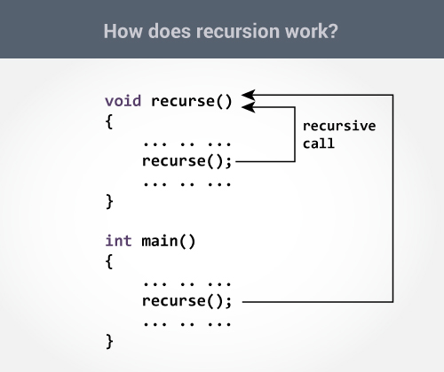

Slide 4
Recursion
The recursion continues until some condition (termination condition) is met.
Always write the termination condition and make sure that the condition is reachable.
Otherwise the recursion WILL NOT STOP!

Slide 5
Will this recursion stop?
import java.util.Scanner;
public class Start {
public static int recurse(int i) {
return recurse(i-1);
}
public static void main(String[] args) {
Scanner scan = new Scanner(System.in);
System.out.print("Enter an integer: ");
int i = scan.nextInt();
System.out.println(recurse(i));
}
}

Slide 6
Will this recursion stop?
import java.util.Scanner;
public class Start {
public static int recurse(int i) {
if(i==0)
return 0;
return recurse(i-1);
}
public static void main(String[] args) {
Scanner scan = new Scanner(System.in);
System.out.print("Enter an integer: ");
int i = scan.nextInt();
System.out.println(recurse(i));
}
}
Notes:
0

Slide 7
Will this recursion stop?
import java.util.Scanner;
public class Start {
public static int recurse(int i) {
if(i<=0)
return 0;
return recurse(i-1);
}
public static void main(String[] args) {
Scanner scan = new Scanner(System.in);
System.out.print("Enter an integer: ");
int i = scan.nextInt();
System.out.println(recurse(i));
}
}

Slide 8
What does it print?
public class Start {
public static void recurse(int i) {
if(i<0)
return;
System.out.println(i);
recurse(i-1);
}
public static void main(String[] args) {
recurse(3);
}
}
Notes:
3
2
1
0

Slide 9
What does it print?
public class Start {
public static void recurse(int i) {
if(i<0)
return;
recurse(i-1);
System.out.println(i); }
public static void main(String[] args) {
recurse(3);
}
}
Notes:
0
1
2
3

Slide 10
A recursive function solves a problem where the solution depends on solutions to smaller instances of the same problem.
What problems does recursion solve?

Slide 11
Recursion Example:
Sum of Natural Numbers
Sum(n) = 0 + 1 + 2 + … + (n-1) + n, for all n>=0
Recursion build-up:
  Step, if n>0, Sum(n) = n + Sum(n-1)
  Base, if n=0: Sum(0)=0
Any case will collapse to the base case step by step.

Slide 12
Recursion Example
import java.util.Scanner;
public class Start {
public static int sum(int n) {
if(n==0)
return 0;
return n + sum(n-1);
}
public static void main(String[] args) {
Scanner scan = new Scanner(System.in);
System.out.print("Enter a positive integer: ");
int n = scan.nextInt();
System.out.println(sum(n));
}
}

Slide 13
Output
Enter a positive integer:
3
6

Slide 14
What is the problem of the example?

Slide 15
Task 1
Read in a positive number and compute its factorial using recursion.
Note that your class should be named “T1”, and should contain
  a main function, which does IO
  and a recursive function, int factR(int n), which computes the factorial

Slide 16
Task 1
You may build you recursion as follows.
  Step, if n>1: factR(n) = n * factR(n-1)
  Base, if n=1: factR(1) = 1

Slide 17
Task 2
Read in and compute the greatest common divisor (GCD) of two natural numbers using recursion.
GCD(x, y) is the greatest natural number which divides both x and y
  GCD(6, 5) = 1
  GCD(6, 9) = 3
  GCD(6, 0) = 6
Note that your class should be named “T2” and should contain
  a main function, which does IO
  and a recursive function, int GCD(int x, int y), which computes the GCD of x and y.

Slide 18
Task 2
You can build your recursion as follows.
If x>=y (swap x and y otherwise),
  Step, if y>0: GCD(x, y) = GCD(y, x % y)
  Base, if y=0: GCD(x, 0) = x
For example,
  GCD(9, 6) = GCD(6, 3) = GCD(3, 0) = 3

Slide 19
Submission
Save your java files as T1.java and T2.java, compress them into #####.zip and submit the zip file to iSpace.
Note: ##### is your student ID.

